Slide 1

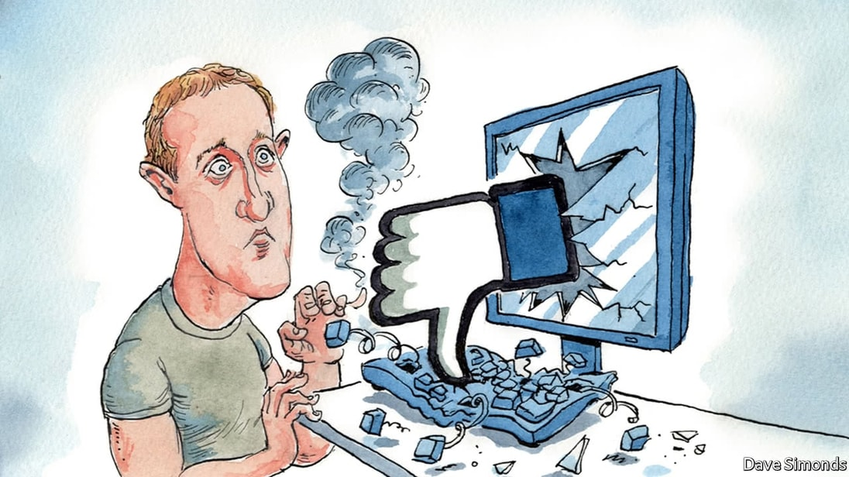
Data Breach in Facebook

Slide 2
Introduction
FACEBOOK
Facebook is a social networking platform owned by Meta Platforms.
Used worldwide except in banned countries like China, Pakistan, N.Korea etc.
As of July 2022, Monthly active users of 2.9B
Involved in the controversy of user privacy issue with Cambridge Analytica
political manipulation in US elections
mass surveillance.

Slide 3
STORY
In April 2019 personal data of over 500 million Facebook users were published in a low-level hacking forum.
The data was hacked due to the vulnerability in security during 2019.
The data published on the hacking site included phone numbers, name, locations, emails and biographical information.
Even though the data is old it can still be used for cyber crimes.
Since the data was already published in the open , there was not much facebook could do to prevent it.

Slide 4
CONSEQUENCES
Privacy violation
Security issues
The stolen information can be used to send spam emails, make calls, mount phishing campaigns and target advertising.
the combination of date of birth, name, phone number and email which provides a useful starting point for identity theft and exploitation.

Slide 5
ETHICAL ASPECT
Inadequate regulation of private user data.
Spread of misinformation and disinformation.
Hate speech, calls to violence, and bullying.
Failing to protect children on a global scale.
Undermine user’s privacy, dignity and self-identity.

Slide 6
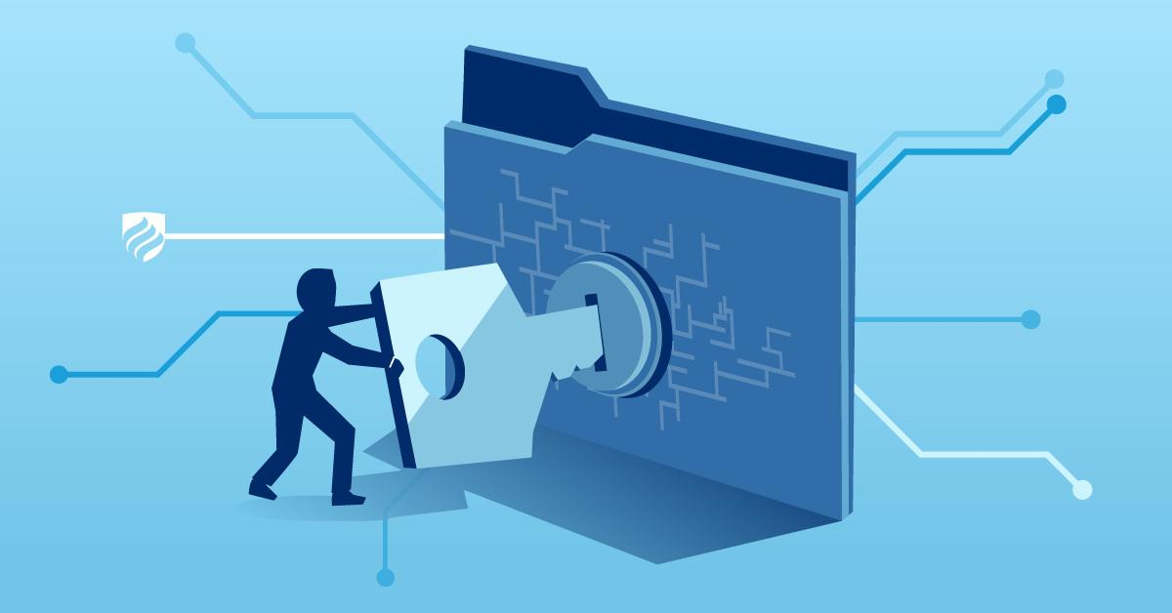
PREVENTION
Individual
  a) Use unique passwords
Company
  Governance(Beaulieu and Leonelli, 2022)
    strict data monitoring and control
    data access management
    manage roles and responsibilities

